Slide 1
Creating the Administration Feature Structure

Slide 2
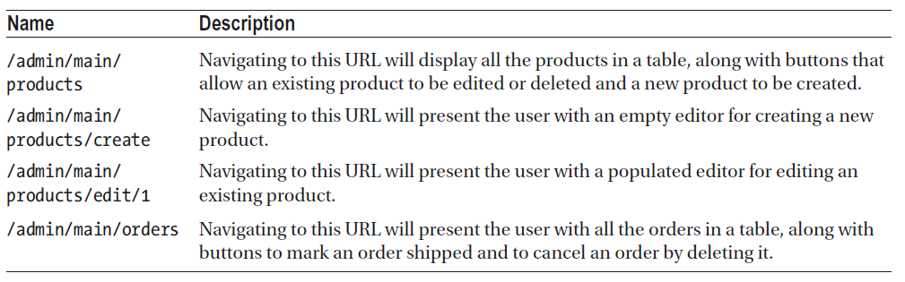
Creating the Administration Feature Structure
Now that the authentication system is in place and the repositories provide the full range of operations, we can create the structure that will display the administration features, which we will create by building on the existing URL routing configuration.
The following Table lists the URLs that we are going to support and the functionality that each will present to the user.

Slide 3
Creating the Placeholder Components
For the administration features, we start by adding a file called productTable.component.ts to the src/app/admin folder with the following code. This component will be responsible for showing a list of products, along with buttons required to edit and delete them or to create a new product.
import { Component } from "@angular/core";
@Component({
template: `<div class="bg-info p-2 text-white">
<h3>Product Table Placeholder</h3>
</div>`
})
export class ProductTableComponent {}

Slide 4
Creating the Placeholder Components (components)
We add a file called productEditor.component.ts in the src/app/admin folder and used it to define the component shown the following code listing, which will be used to allow the user to enter the details required to create or edit a component.
import { Component } from "@angular/core";
@Component({
template: `<div class="bg-warning p-2 text-white">
<h3>Product Editor Placeholder</h3>
</div>`
})
export class ProductEditorComponent { }

Slide 5
Creating the Placeholder Components (components)
To create the component that will be responsible for managing customer orders, we add a file called orderTable.component.ts to the src/app/admin folder and add the following code:
import { Component } from "@angular/core";
@Component({
template: `<div class="bg-primary p-2 text-white">
<h3>Order Table Placeholder</h3>
</div>`
})
export class OrderTableComponent { }

Slide 6
Preparing the Common Content and the Feature Module
The components created in the previous section will be responsible for specific features.
To bring those features together and allow the user to navigate between them, we need to modify the template of the placeholder component that we have been using to demonstrate the result of a successful authentication attempt.

Slide 7
Preparing the Common Content and the Feature Module (continued)
We replace the placeholder content in the admin.component.html file in the src/app/admin folder with the elements shown below:
<div class="container-fluid">
<div class="row">
<div class="col bg-dark text-white">
<a class="navbar-brand">SPORTS STORE</a>
</div>
</div>
<div class="row mt-2">
<div class="col-3">
<button class="btn btn-outline-info btn-block" routerLink="/admin/main/products"
routerLinkActive="active">
Products
</button>
<button class="btn btn-outline-info btn-block" routerLink="/admin/main/orders"
routerLinkActive="active">
Orders
</button>
<button class="btn btn-outline-danger btn-block" (click)="logout()">
Logout
</button>
</div>
<div class="col-9">
<router-outlet></router-outlet>
</div>
</div>
</div>

Slide 8
Preparing the Common Content and the Feature Module (continued)
The template above contains a router-outlet element that will be used to display the components from the previous section.
There are also buttons that will navigate the application to the /admin/main/products and /admin/main/orders URLs, which will select the products or orders features.
These buttons use the routerLinkActive attribute, which is used to add the element to a CSS class when the route specified by the routerLink attribute is active.
The template also contains a Logout button that has an event binding that targets a method called logout.

Slide 9
Preparing the Common Content and the Feature Module (continued)
We add the logout method to the admin.component.ts file in the src/app/admin folder, which uses the authentication service to remove the bearer token and navigates the application to the default URL.
import { Component } from "@angular/core";
import { Router } from "@angular/router";
import { AuthService } from "../model/auth.service";
@Component({
templateUrl: "admin.component.html"
})
export class AdminComponent {
constructor(private auth: AuthService,
private router: Router) { }
logout() {
this.auth.clear();
this.router.navigateByUrl("/");
}
}

Slide 10
Preparing the Common Content and the Feature Module (continued)
We enable the placeholder components in the admin.module.ts file in the src/app/admin folder that will be used for each administration feature and extend the URL routing configuration to implement the URLs from Table:
import { NgModule } from "@angular/core";
import { CommonModule } from "@angular/common";
import { FormsModule } from "@angular/forms";
import { RouterModule } from "@angular/router";
import { AuthComponent } from "./auth.component";
import { AdminComponent } from "./admin.component";
import { AuthGuard } from "./auth.guard";
import { ProductTableComponent } from "./productTable.component";
import { ProductEditorComponent } from "./productEditor.component";
import { OrderTableComponent } from "./orderTable.component";
let routing = RouterModule.forChild([
{ path: "auth", component: AuthComponent },
{ path: "main", component: AdminComponent, canActivate: [AuthGuard],
children: [
{ path: "products/:mode/:id", component: ProductEditorComponent },
{ path: "products/:mode", component: ProductEditorComponent },
{ path: "products", component: ProductTableComponent },
{ path: "orders", component: OrderTableComponent },
{ path: "**", redirectTo: "products" }
]
},
{ path: "**", redirectTo: "auth" }
]);

Slide 11
Preparing the Common Content and the Feature Module (continued)
@NgModule({
imports: [CommonModule, FormsModule, routing],
providers: [AuthGuard],
declarations: [AuthComponent, AdminComponent,
ProductTableComponent, ProductEditorComponent, OrderTableComponent]
})
export class AdminModule {}
Individual routes can be extended using the children property, which is used to define routes that will target a nested router-outlet element.
As you will see, components can get details of the active route from Angular so they can adapt their behaviour.
Routes can include route parameters, such as :mode or :id, that match any URL segment and that can be used to provide information to components that can be used to change their behaviour.

Slide 12
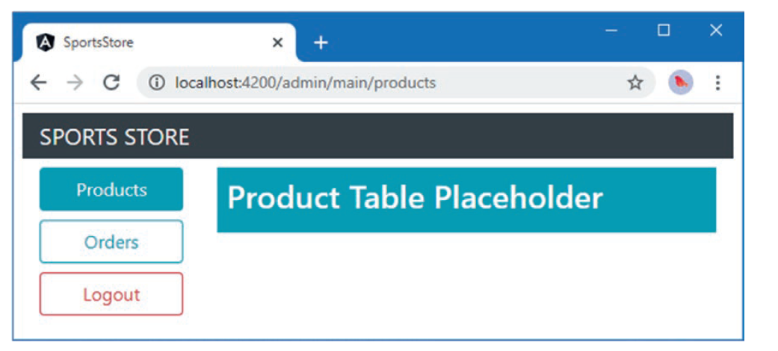
Preparing the Common Content and the Feature Module (continued)
When all the changes have been saved, click the Admin button and authenticate as admin with the password secret.
You will see the new layout, as shown in the following figure.
Clicking the Products and Orders buttons will change the component displayed by the router-outlet element.
Clicking the Logout button will exit the administration area.

Slide 13
Implementing the Product Feature
The initial administration feature presented to the user will be a list of products, with the ability to create a new product and delete or edit an existing one.
The following code listing removes the placeholder content from the productTable.component.ts file in the src/app/admin folder and adds the logic required to implement this feature.
import { Component } from "@angular/core";
import { Product } from "../model/product.model";
import { ProductRepository } from "../model/product.repository";
@Component({
templateUrl: "productTable.component.html"
})
export class ProductTableComponent {
constructor(private repository: ProductRepository) { }
getProducts(): Product[] {
return this.repository.getProducts();
}
deleteProduct(id: number) {
this.repository.deleteProduct(id);
}
}

Slide 14
Implementing the Product Feature (continued)
The component methods provide access to the products in the repository and allow products to be deleted.
The other operations will be handled by the editor component, which will be activated using routing URLs in the component’s template.

Slide 15
Implementing the Product Feature (continued)
To provide the template, we add a file called productTable.component.html in the src/app/admin folder and add the markup shown below:
<table class="table table-sm table-striped">
<thead>
<tr>
<th>ID</th><th>Name</th><th>Category</th><th>Price</th>
<th></th>
</tr>
</thead>
<tbody>
<tr *ngFor="let p of getProducts()">
<td>{{p._id}}</td>
<td>{{p.name}}</td>
<td>{{p.category}}</td>
<td>{{p.price | currency:"USD":"symbol":"2.2-2"}}</td>
<td>
<button class="btn btn-sm btn-warning m-1"
[routerLink]="['/admin/main/products/edit', p._id]">
Edit
</button>
<button class="btn btn-sm btn-danger" (click)="deleteProduct(p._id)">
Delete
</button>
</td>
</tr>
</tbody>
</table>
<button class="btn btn-primary" routerLink="/admin/main/products/create">
Create New Product
</button>

Slide 16
Implementing the Product Editor
Components can receive information about the current routing URL and adapt their behavior accordingly.
The editor component needs to use this feature to differentiate between requests to create a new component and edit an existing one.

Slide 17
Implementing the Product Editor (continued)
The following code listing adds the functionality to the productEditor.component.ts file in the src/app/admin folder required to create or edit products.
import { Component } from "@angular/core";
import { Router, ActivatedRoute } from "@angular/router";
import { NgForm } from "@angular/forms";
import { Product } from "../model/product.model";
import { ProductRepository } from "../model/product.repository";
@Component({
templateUrl: "productEditor.component.html"
})
export class ProductEditorComponent {
editing: boolean = false;
product: Product = new Product();
constructor(private repository: ProductRepository,
private router: Router,
activeRoute: ActivatedRoute) {
this.editing = activeRoute.snapshot.params["mode"] == "edit";
if (this.editing) {
Object.assign(this.product, repository.getProduct(activeRoute.snapshot.params["id"]));
}
}
save(form: NgForm) {
this.repository.saveProduct(this.product);
this.router.navigateByUrl("/admin/main/products");
}
}

Slide 18
Implementing the Product Editor (continued)
Angular will provide an ActivatedRoute object as a constructor argument when it creates a new instance of the component class, and this object can be used to inspect the activated route.
In this case, the component works out whether it should be editing or creating a product and, if editing, retrieves the current details from the repository.
There is also a save method, which uses the repository to save changes that the user has made.

Slide 19
Implementing the Product Editor (continued)
To provide the component with a template, we add a file called productEditor.component.html in the src/app/admin folder and added the markup shown:
<div class="bg-primary p-2 text-white" [class.bg-warning]="editing"
[class.text-dark]="editing">
<h5>{{editing ? "Edit" : "Create"}} Product</h5>
</div>
<form novalidate #form="ngForm" (ngSubmit)="save(form)">
<div class="form-group">
<label>Name</label>
<input class="form-control" name="name" [(ngModel)]="product.name" />
</div>
<div class="form-group">
<label>Category</label>
<input class="form-control" name="category" [(ngModel)]="product.category" />
</div>
<div class="form-group">
<label>Description</label>
<textarea class="form-control" name="description"
[(ngModel)]="product.description">
</textarea>
</div>
<div class="form-group">
<label>Price</label>
<input class="form-control" name="price" [(ngModel)]="product.price" />
</div>
<button type="submit" class="btn btn-primary m-1" [class.btn-warning]="editing">
{{editing ? "Save" : "Create"}}
</button>
<button type="reset" class="btn btn-secondary" routerLink="/admin/main/products">
Cancel
</button>
</form>

Slide 20
Implementing the Product Editor (continued)
The template contains a form with fields for the properties defined by the Product model class, with the exception of the _id property, which is assigned automatically by the RESTful web service.
The elements in the form adapt their appearance to differentiate between the editing and creating features.

Slide 21
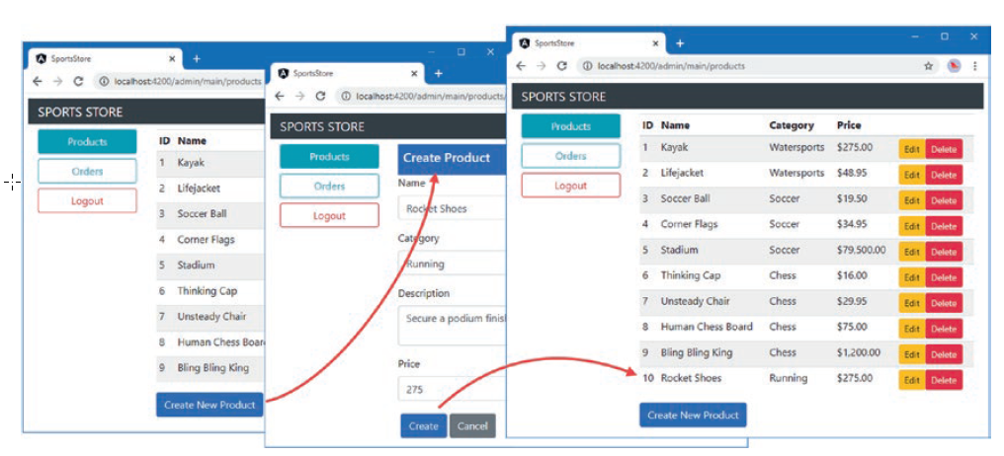
Implementing the Product Editor (continued)
To see how the component works, authenticate to access the Admin features and click the Create New Product button that appears under the table of products.
Fill out the form, click the Create button, and the new product will be sent to the RESTful web service where it will be assigned an _id property and displayed in the product table, as shown:

Slide 22
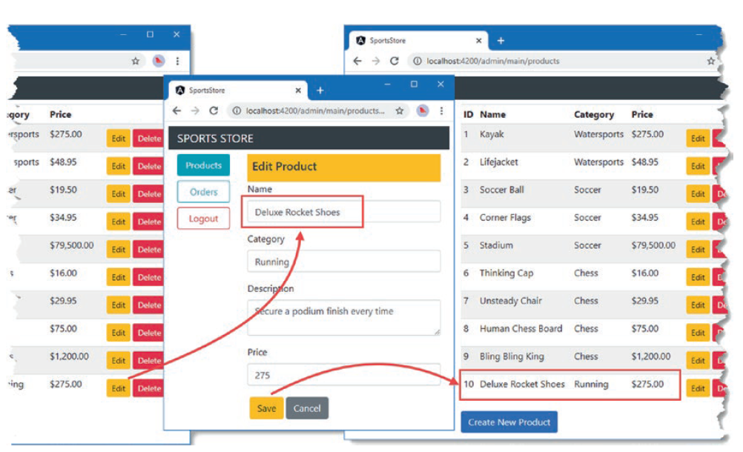
Implementing the Product Editor (continued)
The editing process works in a similar way.
Click one of the Edit buttons to see the current details, edit them using the form fields, and click the Save button to save the changes, as shown:

Slide 23
Implementing the Orders Feature
The order management feature is nice and simple. It requires a table that lists the set of orders, along with buttons that will set the shipped property to true or delete an order entirely.
The following code listing replaces the placeholder content in the orderTable.component.ts file in the src/app/admin folder with the logic required to support these operations.
import { Component } from "@angular/core";
import { Order } from "../model/order.model";
import { OrderRepository } from "../model/order.repository";
@Component({
templateUrl: "orderTable.component.html"
})
export class OrderTableComponent {
includeShipped = false;
constructor(private repository: OrderRepository) {}

Slide 24
Implementing the Orders Feature (continued)
getOrders(): Order[] {
return this.repository.getOrders()
.filter(o => this.includeShipped || !o.shipped);
}
markShipped(order: Order) {
order.shipped = true;
this.repository.updateOrder(order);
}
delete(id: number) {
this.repository.deleteOrder(id);
}
}

Slide 25
Implementing the Orders Feature (continued)
In addition to providing methods for marking orders as shipped and deleting orders, the component above defines a getOrders method that allows shipped orders to be included or excluded based on the value of a property called includeShipped.
This property is used in the template, which we create by adding a file called orderTable.component.html to the src/app/admin folder with the markup shown:
<div class="form-check">
<label class="form-check-label">
<input type="checkbox" class="form-check-input" [(ngModel)]="includeShipped"/>
Display Shipped Orders
</label>
</div>
<table class="table table-sm">
<thead>
<tr><th>Name</th><th>Zip</th><th colspan="2">Cart</th><th></th></tr>
</thead>

Slide 26
Implementing the Orders Feature (continued)
<tbody>
<tr *ngIf="getOrders().length == 0">
<td colspan="5">There are no orders</td>
</tr>
<ng-template ngFor let-o [ngForOf]="getOrders()">
<tr>
<td>{{o.name}}</td><td>{{o.zip}}</td>
<th>Product</th><th>Quantity</th>
<td>
<button class="btn btn-warning m-1" (click)="markShipped(o)">
Ship
</button>
<button class="btn btn-danger" (click)="delete(o.id)">
Delete
</button>
</td>
</tr>
<tr *ngFor="let line of o.cart.lines">
<td colspan="2"></td>
<td>{{line.product.name}}</td>
<td>{{line.quantity}}</td>
</tr>
</ng-template>
</tbody>
</table>

Slide 27
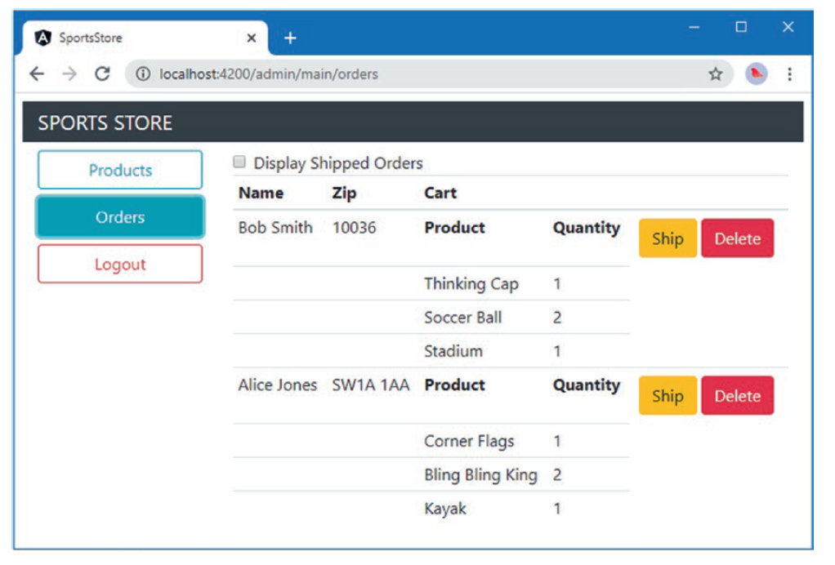
Implementing the Orders Feature (continued)
Remember that the data presented by the RESTful web service is reset each time the process is started, which means you will have to use the shopping cart and check out to create orders.
Once that’s done, you can inspect and manage them using the Orders section of the administration tool, as shown:

